Slide 1
Team A
Presentation

Slide 2
Team members
Ben – team leader(Web & DB part)
Ann – (Web & DB part)
Eric – (Sensor part)
John – (App client part)
Jerry – (App client part)

Slide 3
INDEX
1. What we did
2. Details of function
3. Web Client Part
4. App client part
Notes:
Explain What we did
Details of function we will make
And Web and app client announcement will follow

Slide 4
What we did?
Team meeting in the every morning
- Share each parts information.
Team meeting in the every evening
- Talk about architecture, Suggest direction, etc…
Notes:
So, What we did last week.

Slide 5
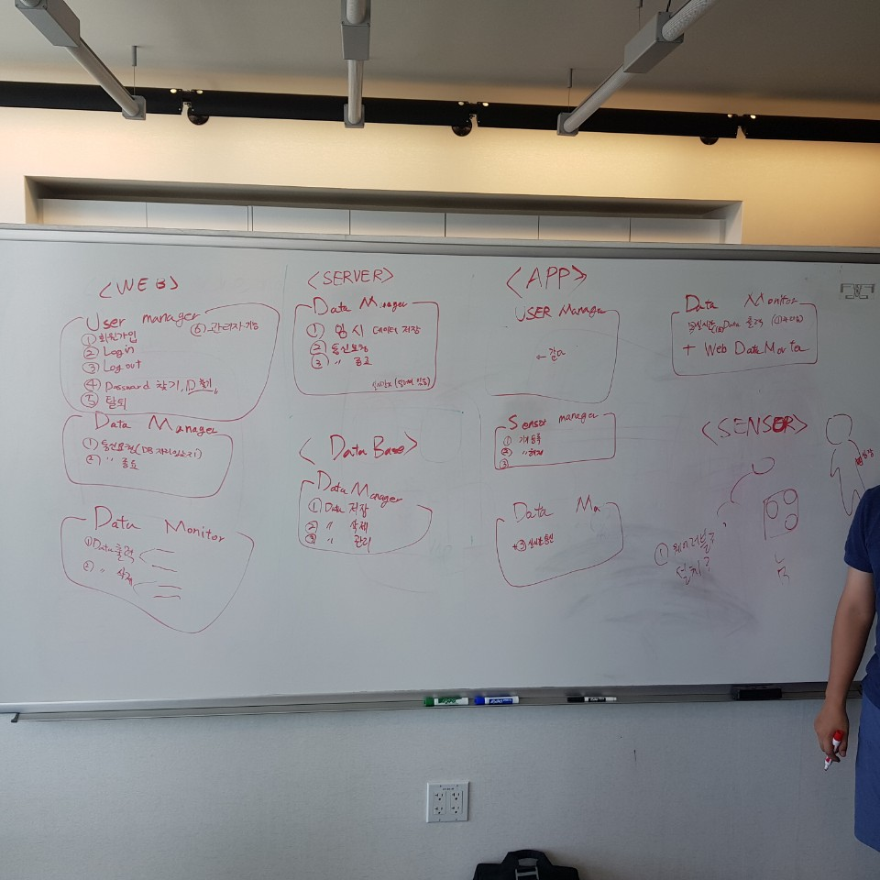
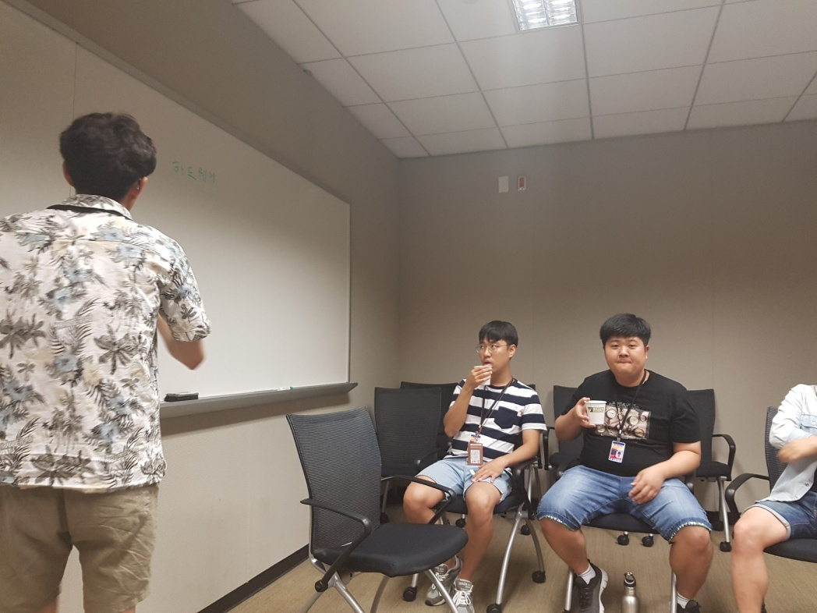
Morning meeting
Notes:
I will explain only the Big features. Listen to each speaker for detail function.

Slide 6
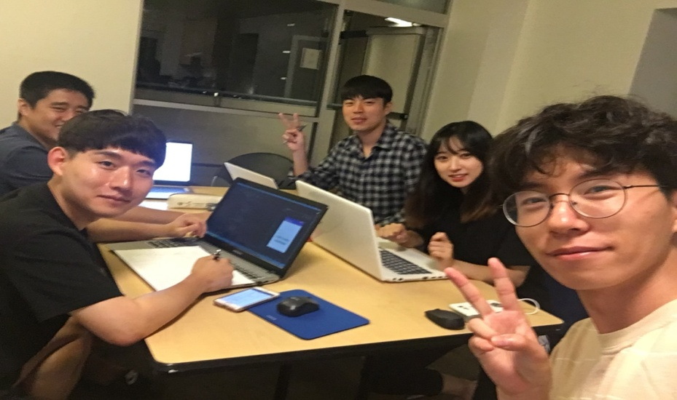
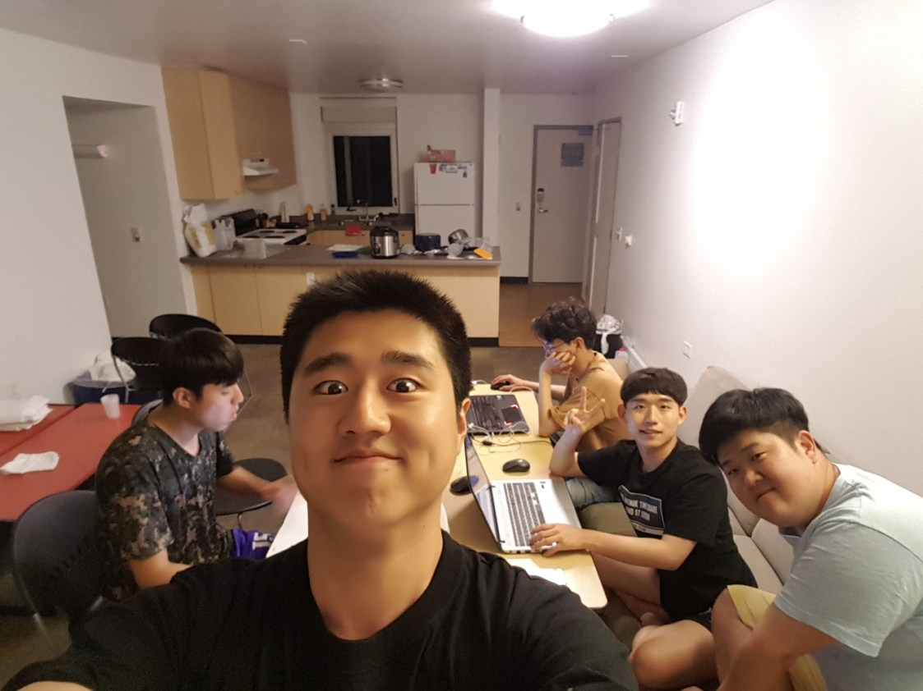
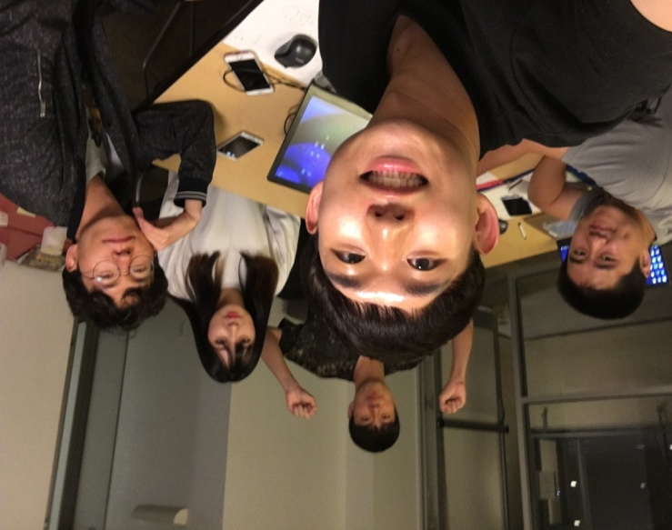
Evening meeting

Slide 7
Details of function
SENSOR Client
Data Management
Sensor Management
- Real-time Communication
Device Enrollmen
Device Release
Notes:
The presenter will tell you how this works and details

Slide 8
Details of function
WEB/DB/SERVER
WEB Client
User Management
Data Monitor
- sign-in
- register ID(e-mail)
- Find ID or Password
- sign-out
- cancel ID
- Display Data
- Filtering Data
WEB SERVER
DataBase
Data Management
Data Management
- Save Temporary Data
- Save Data
- Send Data

Slide 9
Details of function
APP Client
User Management
Sensor Management
- sign-in
- register ID(e-mail)
- Find ID or Password
- sign-out
- cancel ID
- Device Enrollment
- Device Release
Data Management
Data Monitor
- Save Data
- Filtering Data
- Real-time Communication
- Display Data
- Real-time Display Data

Slide 10
Web Client functions
1. User Management.
Sign-in
Register ID(e-mail)
Find ID or Password
Sign-out
Cancel ID

Slide 11
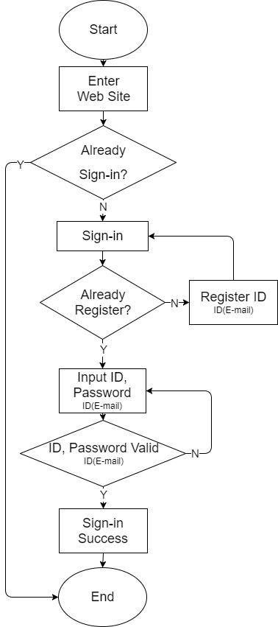
Sign-in
First, if user already sign-in , website automatically memorize user information and sign-in. or not user need to sign-in.
next, if user already registered , just input ID & Password , or not they should have to register ID.
- then, check ID, password valid.
- Sign-in success.

Slide 12
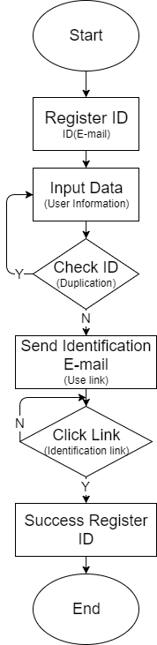
2. Register ID(e-mail)
First, user input some kinds of information.
Check duplication of ID, if it is not valid, user should have to make another ID.
And then , to check identification , we send link to user e-mail.
Click the link then registration complete.

Slide 13
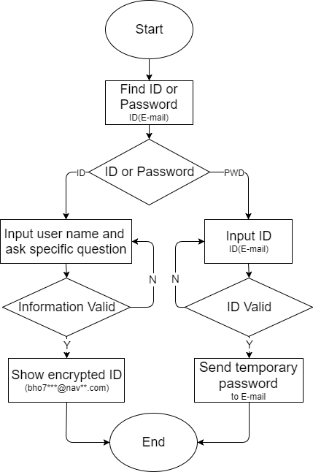
3. Find ID or Password
User chooses whether to find an ID or a password.
If user choose find ID , input user name and check specific question. If information is valid , show encrypted ID
Or user choose find Password, input ID to receive temporary password by e-mail.

Slide 14
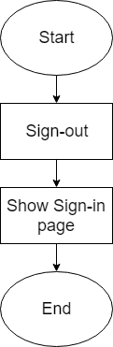
4. Sign-out
- When user sign-out, revert to sign-in page

Slide 15
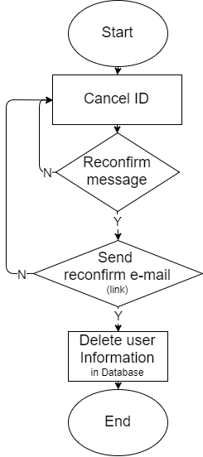
5. Cancel ID(e-mail)
- If user want to cancel-id and agree the message delete all user information in database.

Slide 16
Web Client functions
2. Data Monitoring.
1) Display data
- Display AQI(Air Quality Index) , heartbeat rates data from the server
by some kinds of digit-display or graphs & chart.
2) Filtering data
- User can choose specific data such as daily, weekly, montly averages and
specific area(cities, states, national, international) data.

Slide 17
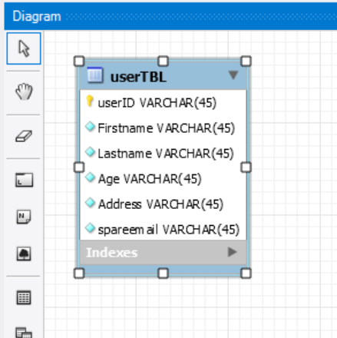
ER Diagram - UserTable
User TBL
- It doesn’t have any relations.

Slide 18
App Client functions
1. Sensor Management.
1) Device Enrollment
- by bluetooth, it connect app and device, and send/receive data
2) Device Release
- disconnect from app and device

Slide 19
App Client functions
2. Data Management.
1) Save data
- The date is stored in the Android database and , sent to web database through SQLite.
2) Filtering data
- Data such as heart rate and air quality values ​​are managed by dividing to date,
and air quality data is managed by dividing to region.
3) Real-time communication
- Receive the measured value from the sensor in real time every second and send it
to the server every 10 seconds.

Slide 20
App Client functions
3. Data Monitoring
1) Display data
- Through app page, heart rate and air quality value is outputted,
and The users can see the past data from the web database for two month.
2) Display Real-time data
When the sensor receives the measured value every second, it display real-time data
through the app.

Slide 21
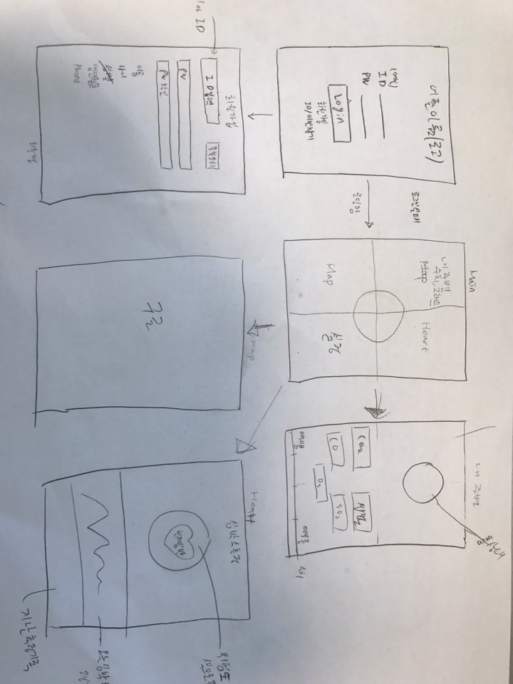
UI & Function

Slide 22
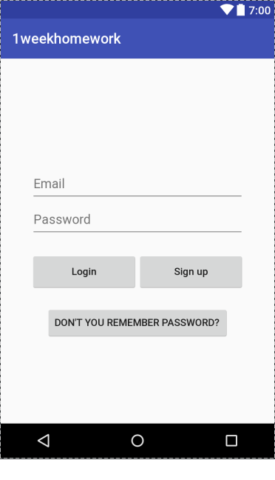
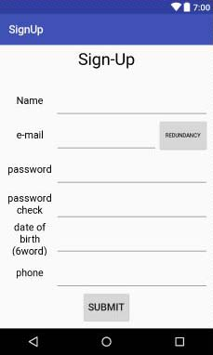
UI & Function
Sing-in
Register ID

Slide 23
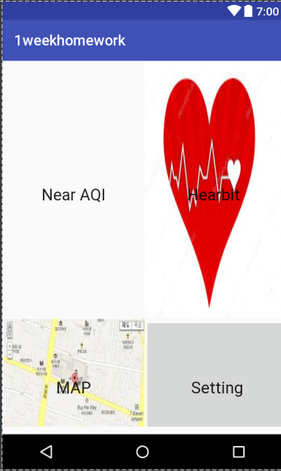
UI & Function

Slide 24
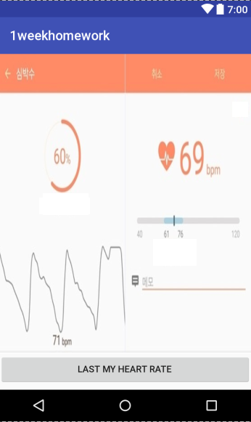
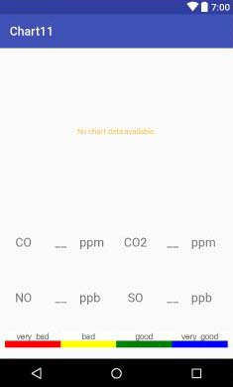
UI & Function

Slide 25
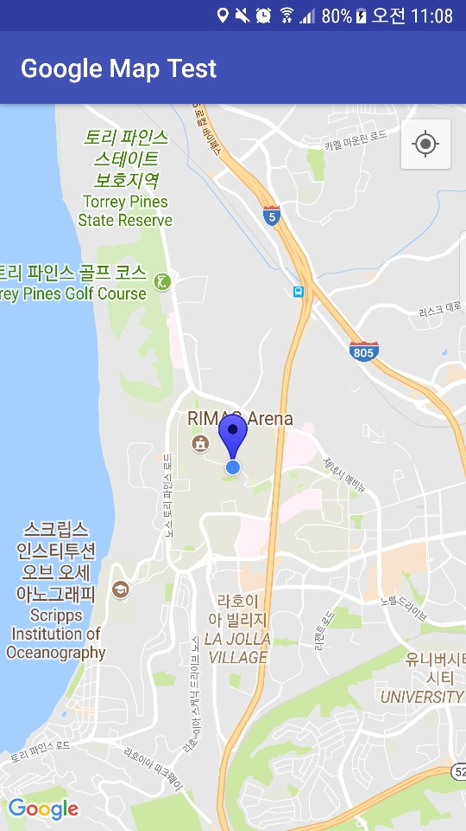
UI & Function

Slide 26
Thank you

